Slide 1

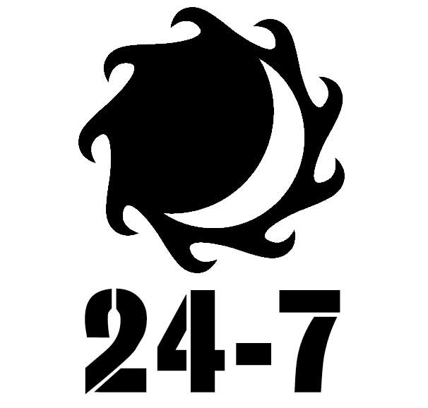
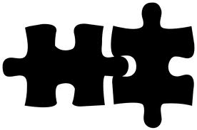






WEAV
Your networking companion
NETWORKING RE-IMAGINED
Traditional networking is powerful.
But it’s also inefficient and cluttered.
We’re out to fix this.
Get early access
How is Weav Better than Traditional Networking?
Weav gives you the right tools to increase the efficiency of your networking, whatever your objectives!
Anytime, anywhere
Meet the right match
Improve your conversion
With Weav you’re no longer restricted to your annual cocktail reception to make new business connections.
With the ability to meet new people from your office or your bed, you can increase your business network when it most matters to you.
Meeting new people is fun, but sometimes you’d like to know if your match can help you reach your goals.
Weav’s matching algorithm takes your needs into consideration and matches you with the people who bring you the most value.
Weav keeps track of all your interactions, it helps you manage your relationships by giving you follow-up reminders. Weav also gives you smart suggestions to nurture your existing connections and grow your network in a meaningful way.
Why does networking matter?
Whether you’re a senior executive, running your own business or working your way up the corporate ladder,
networking is essential to your career.
People from the following companies have already signed up
Join them now

